Slide 1
Class Basics
Prepared by Dr. Jacobo O. Gonzales

Slide 2
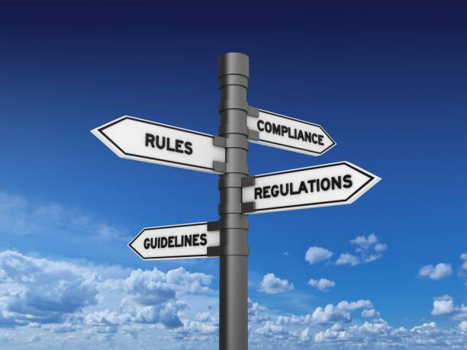
My Expectations of Student Attitude & Behavior
1. Follow instructions strictly!
Instructions provide you a clear roadmap to complete a task correctly, reducing your chance of errors or misunderstandings.
By following instructions, you can complete a task in a timely manner without having to repeat it all over again.
In the school setting, following instructions demonstrates your reliability and trustworthiness to your classmates and teachers.
In certain situations, instructions are crucial for your well-being and safety. Not following instructions may be a matter of life or death.

Slide 3

My Expectations of Student Attitude & Behavior
2. Be self-directed, needing minimum
reminders from teacher, supervision by parents, or external motivation!
Self-directed learners actively seek out information and evaluate its credibility, enhancing their analytical skills.
Self-directed students practice essential skills like goal setting, time management, research, and self-regulation while navigating their learning journey.
Taking control of your learning journey leads to a stronger sense of purpose and higher intrinsic motivation.
Taking responsibility for your learning fosters a sense of accomplishment and self-efficacy.

Slide 4
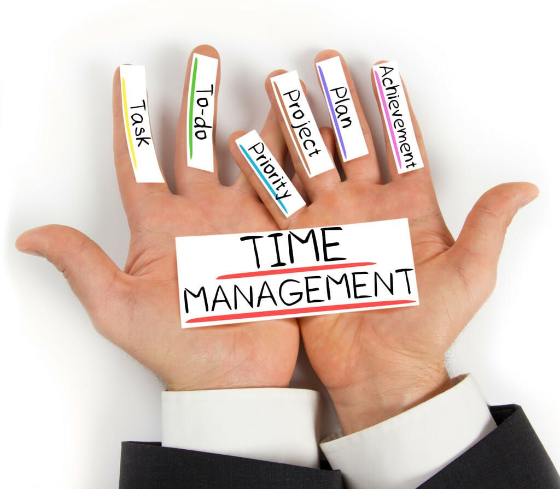
My Expectations of Student Attitude & Behavior
3. Manage your time wisely!
By planning your study periods and avoiding last-minute cramming, you experience less anxiety and pressure, especially around exams time.
By calendaring your tasks, you can identify the most important tasks and allocate adequate time to them, ensuring that key concepts are covered thoroughly.
Breaking down large tasks into smaller, more manageable chunks will help you avoid putting off accomplishing them until the last minute.
Effective time management allows you to dedicate time for both academics and other aspects of life like hobbies, social activities, and self-care.

Slide 5

My Expectations of Student Attitude & Behavior
4. Solve problems
with patience,
persistence and
honesty!
Patience allows you to take the time needed to fully grasp concepts rather than rushing through them, leading to a stronger foundation in your studies.
Persistence helps you develop critical thinking and analytical skills, enabling you to tackle complex problems efficiently.
Honesty ensures that you truly learn from your studies instead of taking shortcuts, (such as copying, cheating, etc.) fostering genuine knowledge and ethical behavior.
These qualities develop a strong work ethic, which is crucial not only for academic achievements but also for career growth and personal development.

Slide 6

My Expectations of Student Attitude & Behavior
5. Communicate ideas effectively
in either English or Filipino!
Good communication skills enable students to engage in class discussions and present ideas confidently.
Effective communication fosters trust among students and teachers, creating a positive learning environment.
When students can communicate clearly with each other, they can work effectively in teams and collaborate on projects.
Students who can communicate their difficulties can readily seek support from teachers when needed.

Slide 7

My Expectations of Student Attitude & Behavior
6. Be open to study further and
do some form of research!
Research helps you gain a deeper understanding of complex topics by exploring new ideas and perspectives, going beyond basic knowledge.
Demonstrating a willingness to learn and conduct research can make you a more competitive candidate in the job market.
Fields are constantly evolving, so ongoing study and research help you stay current with the latest developments.
Engaging in research can stimulate intellectual curiosity, broaden your horizons, and foster a lifelong learning mindset.

Slide 8
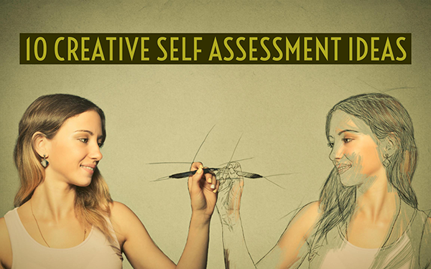
My Expectations of Student Attitude & Behavior
By reflecting on your own work, you gain a deeper understanding of your learning process, identifying areas where you excel and where you need to focus more effort.
Self-assessment allows you to set realistic goals based on your current abilities, providing a roadmap for future learning.
The process of self-assessment encourages you to think critically about your own thinking (metacognition), which is a crucial skill for effective learning.
Self-assessment promotes a sense of control, allowing you to take control of your learning journey.
7. Self-assess your own understand,
processes, progress, and outputs!

Slide 9

My Expectations of Student Attitude & Behavior
8. Present solutions that are well thought of!
Thinking through a problem allows you to identify the relevant information, choose appropriate strategies, and adapt your approach to different scenarios.
Analyzing a problem from different angles and evaluating the logic of your steps cultivates critical thinking skills that are valuable in various fields.
Carefully considering each step can help you catch mistakes and avoid careless errors in your calculations.
When you understand the reasoning behind your answer, you gain confidence in your mathematical abilities to tackle more challenging problems.

Slide 10

My Expectations of Student Attitude & Behavior
9. Submit presentable outputs on time!
Meeting deadlines teaches you how to plan and prioritize your work, which is crucial for managing a busy schedule in school and beyond.
Consistently submitting assignments on time demonstrates a commitment to your studies and accountability for your actions.
Students who submit work on time tend to have better grades overall as they are more likely to complete assignments thoroughly.
Employers value employees who can meet deadlines and manage their time effectively, making on-time project submission a valuable life skill.

Slide 11

My Expectations of Student Attitude & Behavior
10. Accept corrections
constructively and ungrudgingly!
By acknowledging areas where you can improve and actively working on them, you can develop new skills and become more competent in your work or personal life.
Accepting feedback can lead you to better collaborations and can create a stronger reputation for you as a willing learner.
When you show openness to feedback, it demonstrates trust and respect towards the person offering the correction, strengthening your relationships with teachers, classmates, friends, or family.
By considering different perspectives and being open to constructive criticism, you can make more informed decisions and avoid potential pitfalls.

Slide 12
General Flow of Engagement in Every Class Period
Read the day’s agenda, announcement, instructions and reminders in our MS Teams and Messenger GC.
Check-in in class by writing your name (family name, first name) and the time you came into the classroom and by signing in a provided attendance sheet.
Pray at the start of the class.
Listen to the teacher’s review of the previous lesson and/or presentation of a new lesson.
Check-out from class by writing a brief lesson summary or by taking a short quiz or by praying at the end of the class.
Subject materials will be uploaded in MS Teams either before (for advance reading) or after (for review) each class period.

Slide 13
Way of Communication
Mainly through MS Teams
Teacher:
post class meeting agenda
send private message
upload subject materials (PPTs, docs, videos, links)
upload exercises or exams, whether in MS Form (auto-graded) or not
Student:
access subject materials
upload outputs or answers to assignments
submit answers to exercises, quiz, or exams in MS Form
send explanation letter for absence with proof (e.g., medical certificate)

Slide 14
Grading System
Grade = Raw Score divided by Perfect Score times 50 plus 50
50% passing, equivalent to a grade of 75
Grade Components Percentage
Attendance 10%
Activities (Recitation, Self-tests, Exercises, Short Quizzes) 30%
Performance Tasks 20%
Examinations 30%
Attitude & Behavior (Student-rated/Teacher-rated) 10%
Total 100%

Slide 15
Example of a Performance Task Grade:
Example of an Activity or Exam Grade:
Example of an Attendance Grade:
100 – 4(Number of Hours Late or Absent)
100 – 4(13 hours)
= 100 – 52 = 48
Note:
You will be considered Unofficially Dropped (UD)
if you accumulate more than 12.8 hours of absence/late for the whole semester
if you no longer attend or submit any output after October 11.

Slide 16
TUP Student Handbook Provision on Attendance
A student must attend classes regularly.
Any student who, for unavoidable circumstances, absents himself from class must submit an excuse letter duly signed by the parent or guardian … and presents the same to the instructor/professor concerned.
When a student incurs absences equivalent to 20% of the total number of hours required in a particular subject, he shall be dropped from the subject; however, consideration may be given to a student by allowing him to make up…

Slide 17
Example of a Final Grade:
Component | Percentage | Average Grade | Computation | Weighted Grade
Attendance | 10%
Activities | 30%
Performance Tasks | 20%
Examinations | 30%
Attitude/Behavior | 10%
Total (Final Grade)
86
86 x 0.1 =
8.60
89.58
89.58 x 0.3 =
26.87
85.76
85.76 x 0.2 =
17.15
78.45
78.45 x 0.3 =
23.54
90
90 x 0.1 =
9.00
85.16

Slide 18
Grade Equivalents
Final Grade | Equivalent
No Attendance and No Output | DRP
00.01 – 74.49 | 5.00
74.50 – 77.49 | 3.00
77.50 – 80.49 | 2.75
80.50 – 83.49 | 2.50
83.50 – 86.49 | 2.25
86.50 – 89.49 | 2.00
89.50 – 92.49 | 1.75
92.50 – 95.49 | 1.50
95.50 – 98.49 | 1.25
98.50 – 100.00 | 1.00
Equivalent Grade
= 2.25
Final Grade
= 85.16

Slide 19
Required Learning Materials
Ballpen, pencil, eraser, sharpener, and ruler
Scientific calculator
4 sheets of long yellow ruled pad paper from each student in the class to be collected on our 2nd class meeting.
To fulfill this last requirement the class representative may also collect money from the members of the class and then buy two 80-sheet standard yellow long pad paper.
(a total of 160 sheets)

Slide 20
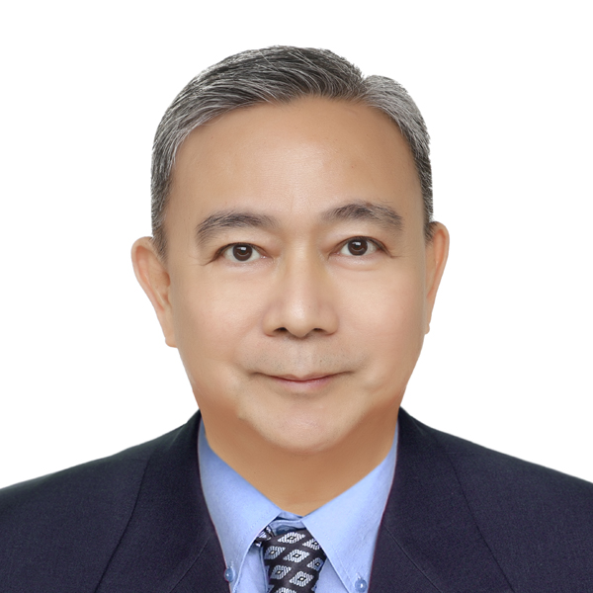
Professor – Your Learning Facilitator
Jacobo Ocampo Gonzales (Sir Bob or Sir JOG)
Bachelor of Science in Education,
major in Mathematics (minor in English) from Don Bosco Seminary
Master of Mathematics Education from DLSU-Manila
Doctor of Education, major in educational management from PCU
Math teacher since 1983
Taught in private high schools and tertiary institutions and in state universities namely LSU in Baton Rouge, Louisiana, USA and TUP-Manila where I am currently a part-time math professor under COS.
Co-authored three books: Mathematical Trips in the Modern World
Essential Statistics
Essential College Algebra

Slide 21

I hope we will have a pleasant and productive semester together.

